Slide 1
Exploratory Data Analysis and Prediction of Employee Attrition
Name: Suhas H M
USN: 1RVU22CSE168
Date: 11-11-2024
Institution: School of Computer Science, RV University

Slide 2
Agenda
Introduction
Data Overview
Data Preprocessing
Exploratory Data Analysis
Modeling
Results and Discussion
Conclusion and Future Work

Slide 3

Introduction
Project Background: Address the issue of employee attrition, its impact on organizations, and the need for predictive modeling to identify factors influencing turnover.
Objective: To develop a model that predicts attrition likelihood and identifies key indicators to aid in employee retention.

Slide 4
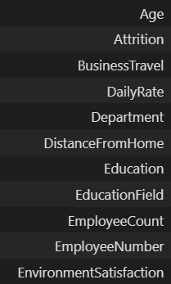
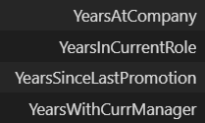
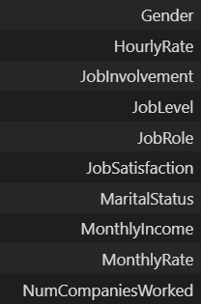
Data Overview
Dataset Summary
Some of the Features in the dataset
Kaggle Employee Attrition dataset with 1,470 records and 35 features, covering demographics, job roles, satisfaction levels, and performance metrics.

Slide 5
Data Preprocessing
Data Cleaning Steps
Feature Engineering and Selection
No missing values or duplicates
Encoded Attrition, OverTime, and Gender as binary columns
dropped redundant columns for model efficiency

Slide 6
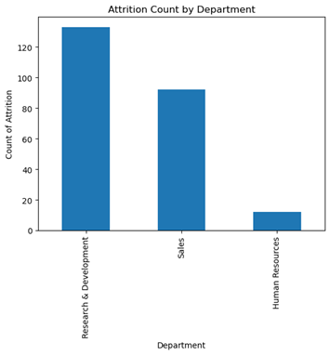
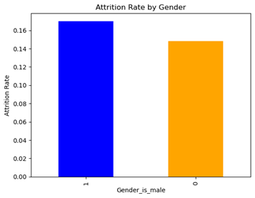
Exploratory Data Analysis (EDA)
1. Bar plots
The male gender are more likely to leave

Slide 7
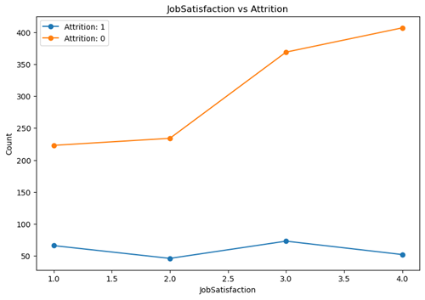
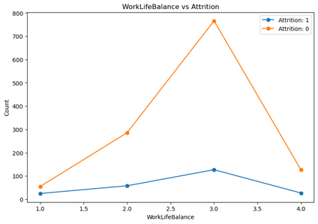
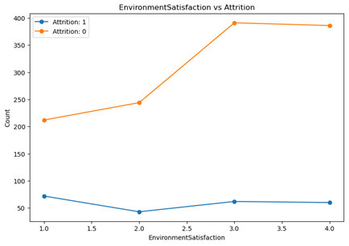
2.Line Plots :
We made 3 plots to visualize how work/life balance, job satisfaction and environment satisfaction were related to attrition:
Mars
Neptune
Despite being red, Mars is actually a cold place. It's full of iron oxide dust, which gives the planet its reddish cast
Neptune is the farthest planet from the Sun. It's also the fourth-largest planet by diameter in the Solar System
Earth
Jupiter
From which we found that better environment satisfaction, job satisfaction and work/life balance corresponds to lesser attrition.

Slide 8
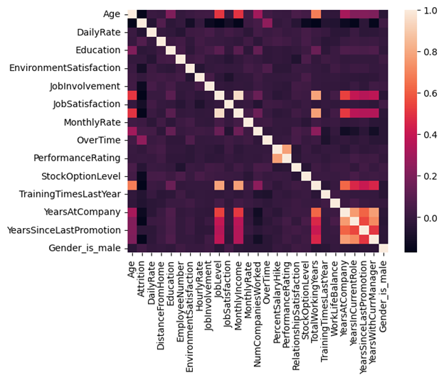
—Someone Famous
3. Correlation Heatmap: The correlation matrix heatmap provides an overview of feature interrelationships.
“This is a quote, words full of wisdom that someone important said and can make the reader get inspired”

Slide 9
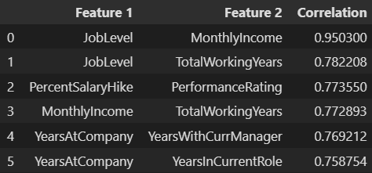
Top-most correlated pairs of features according to the correlation matrix
1. Job Level and Monthly Income: This is expected as higher job levels typically come with higher salaries.
Job Level and Total Working Years: This indicates that employees with more years of experience tend to be at higher job levels. This is logical as more experienced employees are often promoted to higher positions.
Percent Salary Hike and Performance Rating: This suggests that employees who receive higher performance ratings are likely to receive higher percentage salary hikes. This aligns with common performance-based compensation practices.

Slide 10
Modelling Approach
Model Chosen : Random Forest
Why RandomForest?
Feature Engineering and Selection
RandomForest Classifier chosen for its ability in handling classification tasks, categorical and numerical data, and suitability for predicting binary outcomes.
Data was split 80/20 into training and testing sets, ensuring evaluation on unseen data for better generalization.
Key hyperparameters, such as criterion='entropy', max_depth=10, and n_estimators=100, were tuned to optimize the model.

Slide 11
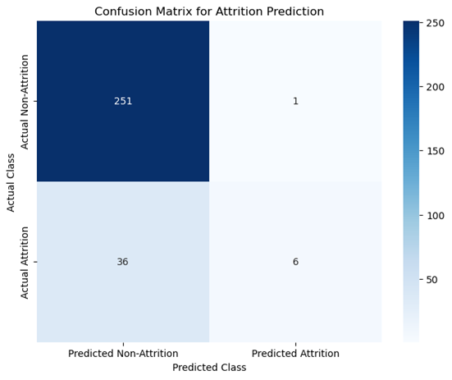
Model Performance
Accuracy
Precision
Recall
F1-Score
Confusion matrix
~87.4%.
0.86
0.14
0.24

Slide 12
Key Findings and Interpretation
Main Results:
Stronger job satisfaction, work-life balance, and environment satisfaction are associated with lower attrition rates.
"Research & Development" department shows higher attrition, indicating possible areas for targeted retention.
Business or Practical Implications:
PHR can focus retention strategies on satisfaction factors and at-risk departments.
Predictive model allows HR to proactively manage and reduce attrition-related
costs by identifying at-risk employees.

Slide 13
Conclusion and Future Work
Summary
The project successfully identified factors contributing to employee attrition and built a predictive model with ~87.4% accuracy. Key insights include the impact of job satisfaction and department-specific attrition rates.
Next Steps
Additional data sources : employee health/satisfaction over time
Future work could explore using other models to perform classification

